Slide 1
Design of the Second Generation JPL Statechart Autocoder
(Owen) Shang-Wen Cheng [316D]
Mentor: Len Reder
Supervisor: Garth Watney
Friday, November 13, 2009
Notes:
Intro self… CMU degree in Software Engineering, worked on software architecture-based self-adaptive systems.
Started this past July today.
Worked on SC Autocoder for the past 4 months.
Emphasize: work builds on prior work of Nick Rouquette, Alex Murray, Garth Watney, Kenneth Clark, Eddie Benowitz

Slide 2
Introductory demo…
Two State Charts from MagicDraw
Autocoder generated Python
Python trace GUI demonstrated state transitions
Notes:
Show two StateCharts, autocoded to Python,
then demonstrated via Python GUI.

Slide 3
Overview
Introductory Demo
Background: StateChart Autocoding History and Process
Second Generation StateChart Autocoder
Feature Highlight: extensible design patterns, use of template
Adding a new backend: YAML example
Feature Roadmap and Future Issues
Conclusion and Q&A
Goals of this talk:
Show-and-Tell of tool’s design
Food-for-thought on where/how tool might be useful at JPL

Slide 4
A brief history of StateChart Autocoder
Problem: getting complex hierarchical state machines right
Gap between system spec and software implementations
Lack of capability to rapidly build executable prototype models
Lack of consistent HSM implementations
Difficult and labor-intensive to code HSM correctly
High software cost, low reliability, low maintainability
Positive experiences from DS1 and Deep Impact FP
System engineers specified monitor-response behaviors with StateCharts defined in Matlab’s Stateflow tool
Stateflow Autocoder generated C code
Post-processing of generated code into flight code
Once the tools were in place – very few software defects were found – mainly design errors
Notes:
Specs often take the form of states, events, & transitions.

Slide 5
StateCharts: a solution to HSM problem
Solution: UML StateChart-based development process
Support UML-standard StateChart specification
Auto-generate patterned code from UML StateCharts
Allow rapid prototype of executable & verifiable state behavior
Facilitate “fleshing-in” of StateCharts with manual flight code
Outcome: a JPL in-house, infrastructure tool leveraging
Common design paradigm – states, events, and transitions
Industry standard – UML StateCharts
*UML modeling tool that outputs standard XMI (MagicDraw)
*Light-weight, O/S-neutral framework for embedded real-time applications (Quantum Framework by Miro Samek)
Notes:
It has been used in AMD (Quantum Framework).
Eddie Benowitz retrofitted old Autocoder design with new back-end for generating MSL’s flat state design pattern.

Slide 6
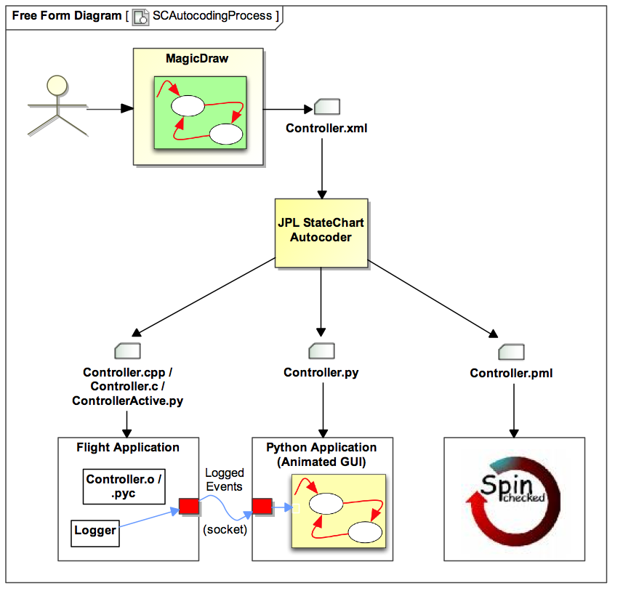
StateChart autocoding process
Optional development-time usage

Slide 7
What’s inadequate about version one?
Original JPL StateChart Autocoder
Proof-of-concept tool
Ad-hoc class representation of UML StateChart elements
Worked only with MagicDraw 12.5
Produced C / C++ / Promela code
Highly-customized to mission project
Hardwired print statements of code snippets
Desiderata: a robust and multi-mission JPL tool
New JPL StateChart Autocoder
Redesigned for extensibility, flexibility, and robustness
Explicit support for different input versions and CASE tool
Direct support for UML Metamodel
Template-based generation to generic implementation pattern
Notes:
UML Metamodel: eventually might even support full UML features

Slide 8
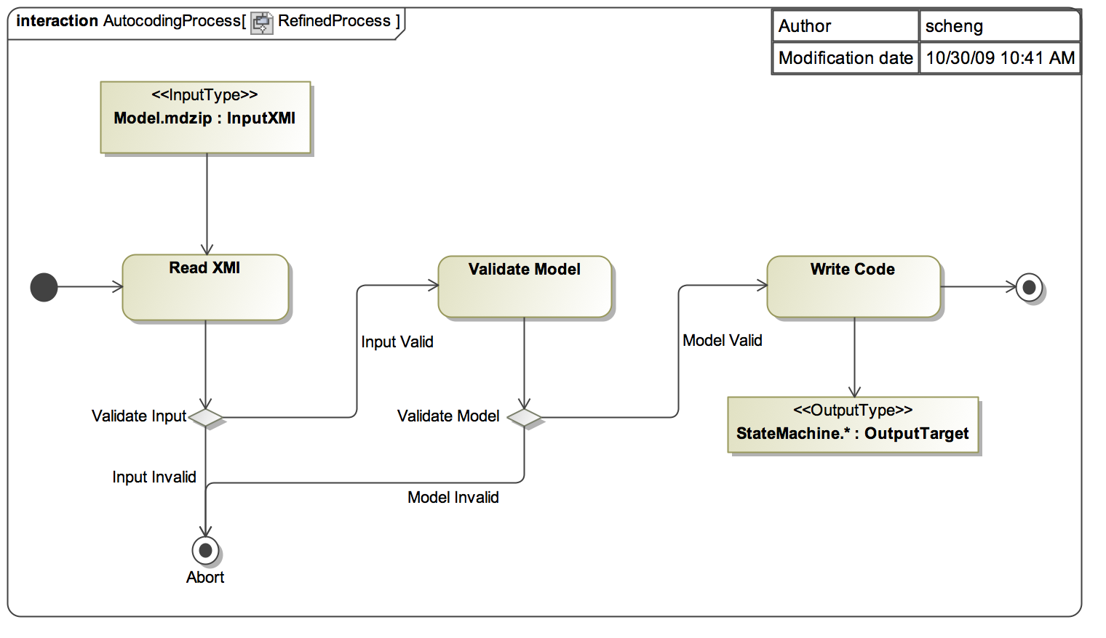
Process of StateChart code-generation tool
Checks UML
model for missing
info, e.g., SignalEvent
without Signal
Uses template
to write out
target code
UML modeling
tool output
Parses XMI
into internal
UML model
SM code in target language
Fatal input or model
issues (i.e., doesn’t allow
producing code that
compiles) cause an abort

Slide 9
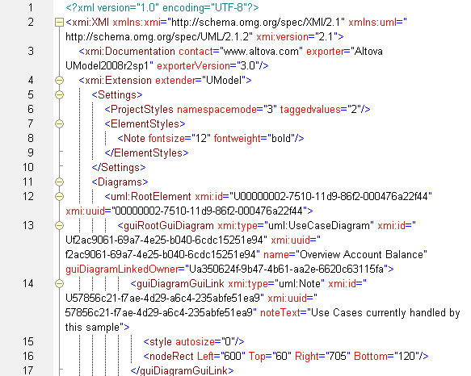

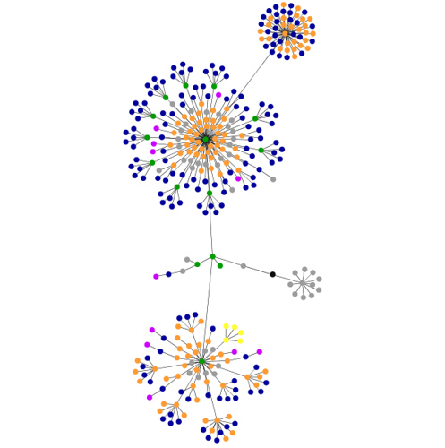

Code-generating flow-cartoon
R
V
W
Notes:
XML → model tree → Template-engine + Querier → code

Slide 10
Features of 2nd generation Autocoder
UML Metamodel implementation in class hierarchy
Extensibility design patterns
UML model validation
Technology-specific reader (interface & annotation)
Robustness to UML version changes (enum + externalize)
Ease of adding new generators (interface & annotation)
Template-based generation
Apache Velocity engine
Modular template files for ease of management
Quantum Framework implementation pattern
Light-weight StateChart technology for real-time embedded systems
Test suites: JUnit whitebox tests + per-language blackbox tests

Slide 11
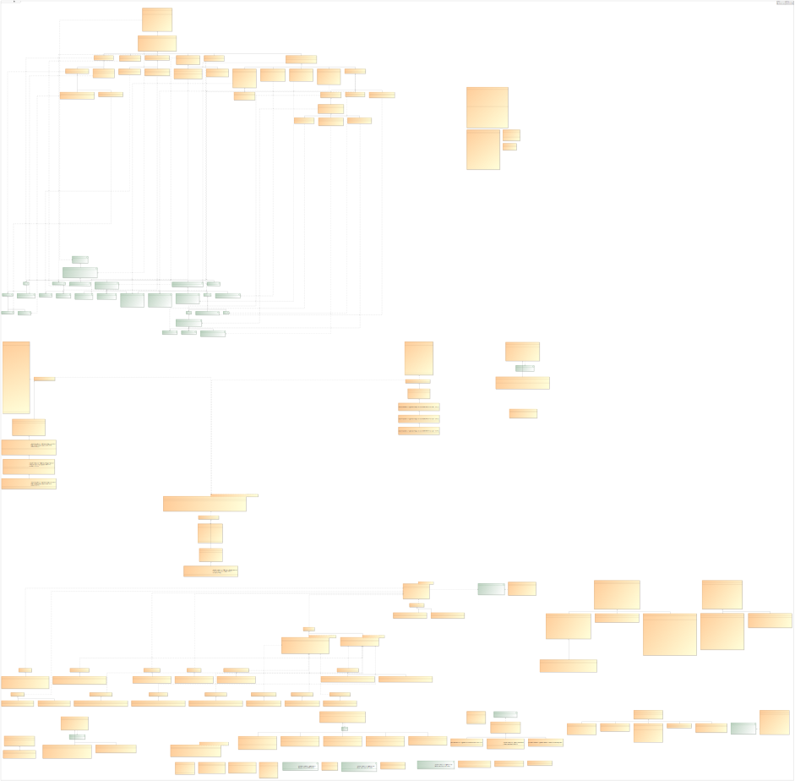
Design in UML from 10,000 feet
UML Metamodel Classes
Main & Utility Classes
R
Reader Classes
W
Writer Classes
Validator Classes
V

Slide 12
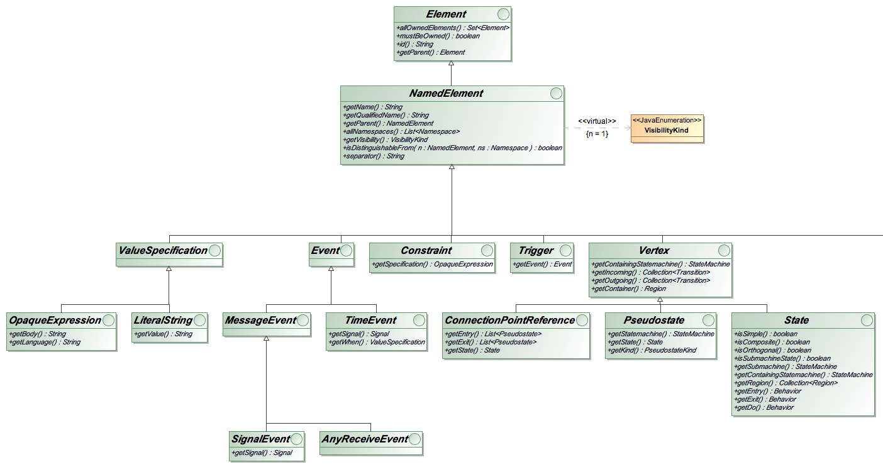
UML Metamodel interface hierarchy
Java interfaces capture the minimally needed set of UML meta-classes for modeling StateCharts.

Slide 13
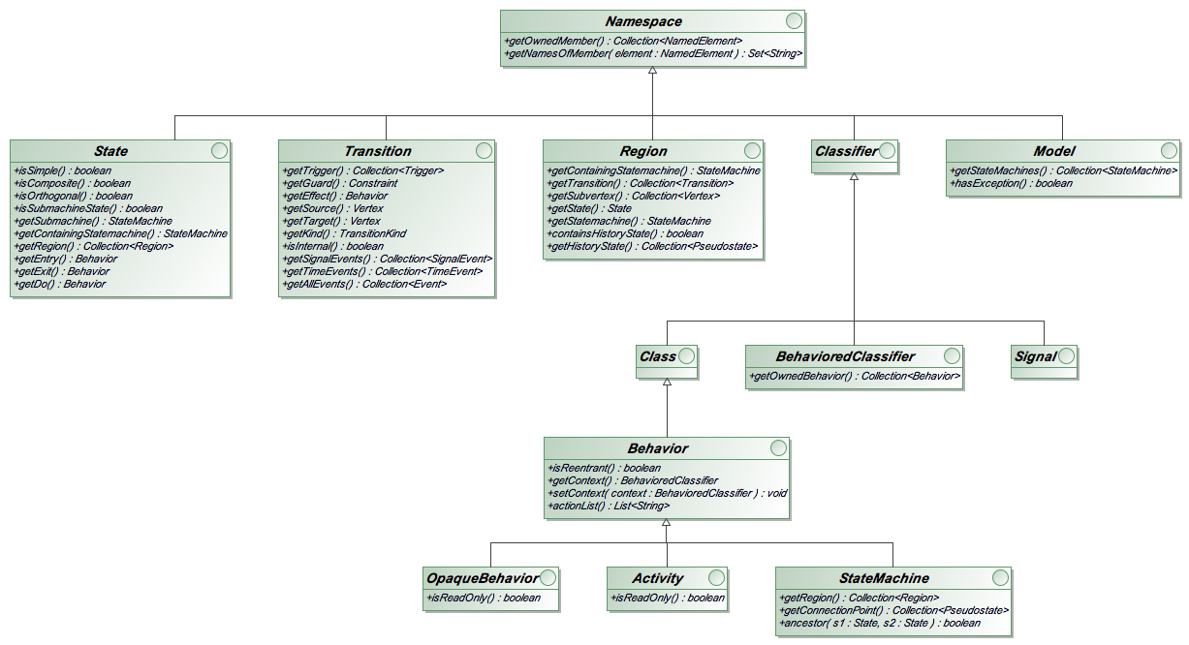
UML Metamodel – Namespace subtypes
Java interfaces for the core UML Namespace subtypes, e.g., StateMachine, State, and Transition.

Slide 14
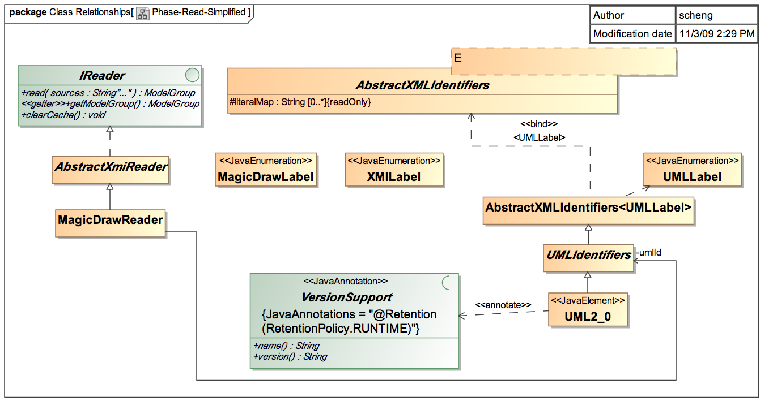
Read phase parses XMI into UML model
R
V
W
Reader interface defines read
for one or more source files.
Common base class to enable version-
specific keywords and read strategies.
e.g., UML…
Easily tailor to different
UML modeling tools.
Java annotation to
decorate classes that
support specific input
version, discoverable.

Slide 15
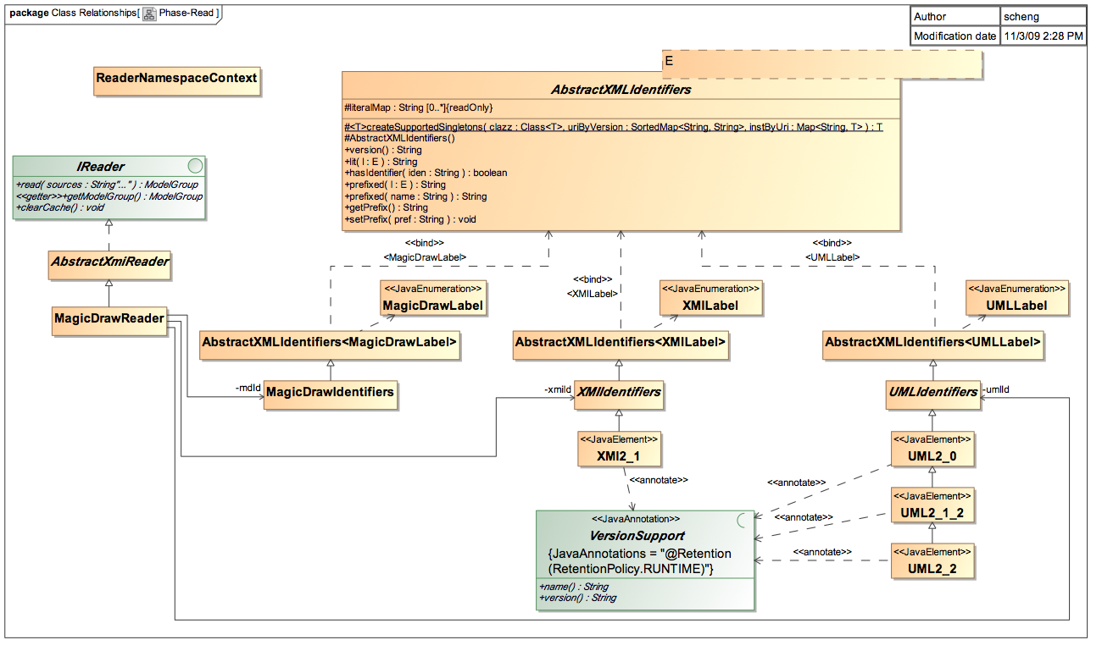
Autocoding Read phase – full set
R
V
W

Slide 16
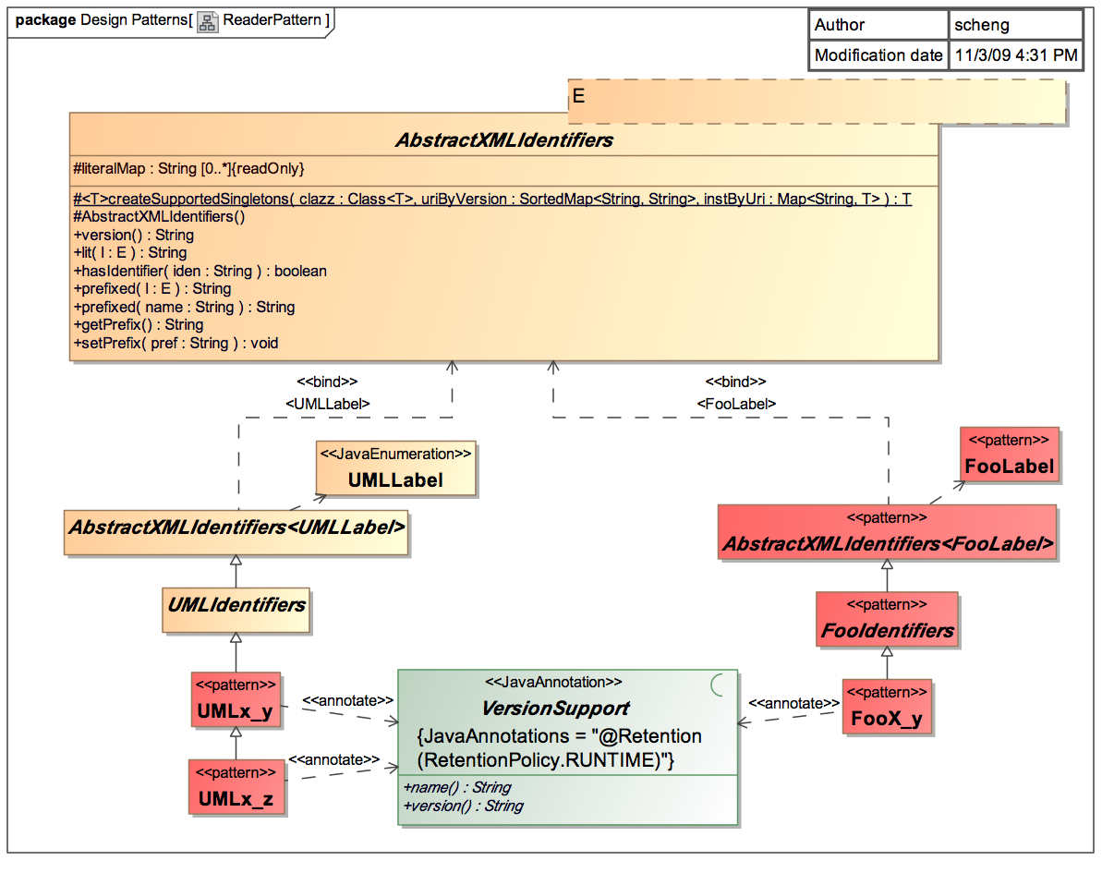
Pattern: Reader and string externalization
R
V
W
Define Label + Identifiers
for new Reader
Changes in label or parse strategy handled
by new version-support
subclass, e.g., UML 2.1
changed ownedMember
to packagedElement

Slide 17
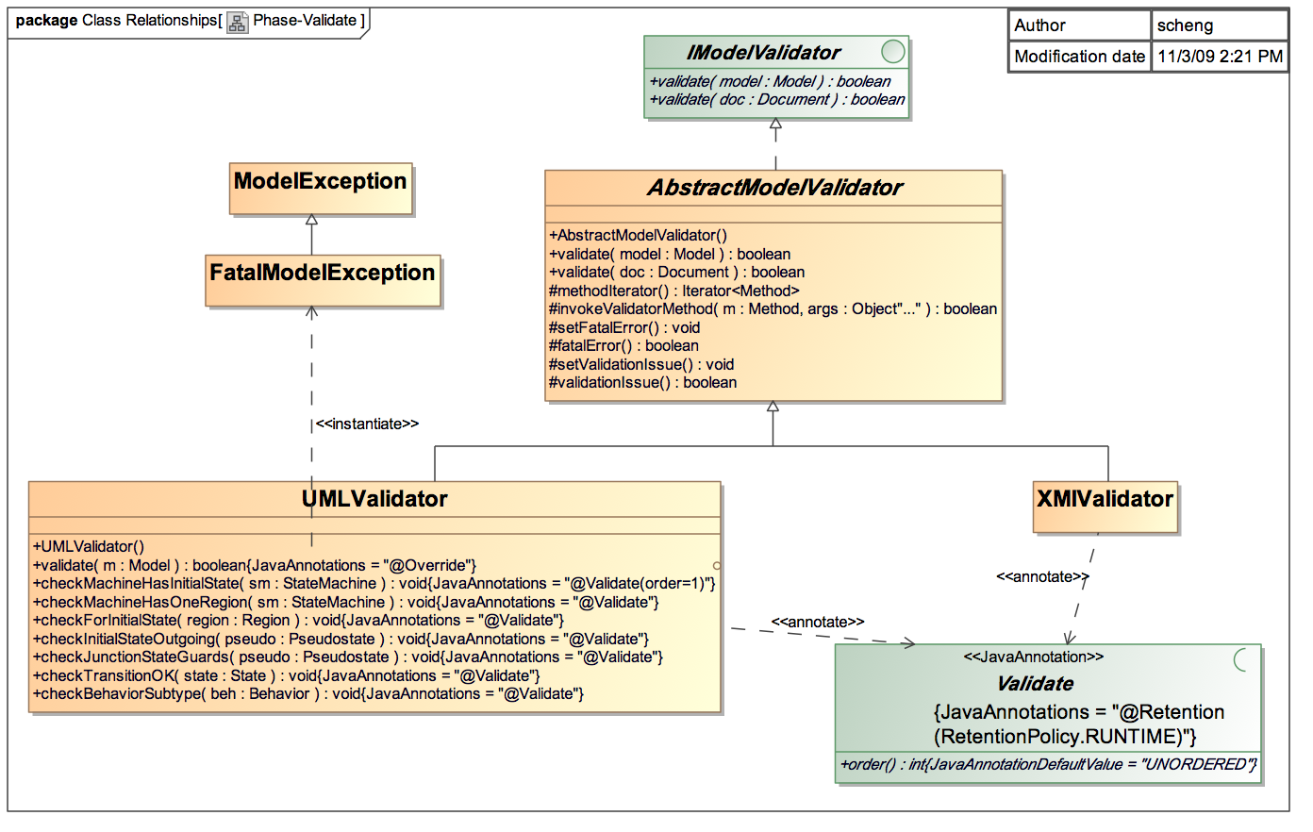
Validate phase checks model fit for code-gen
R
V
W
Check methods
to validate that
UML model is
OK for
producing code.
Validator interface
Defines validate
methods for model
and generic doc.
Java annotation for
discoverable validate
methods.

Slide 18
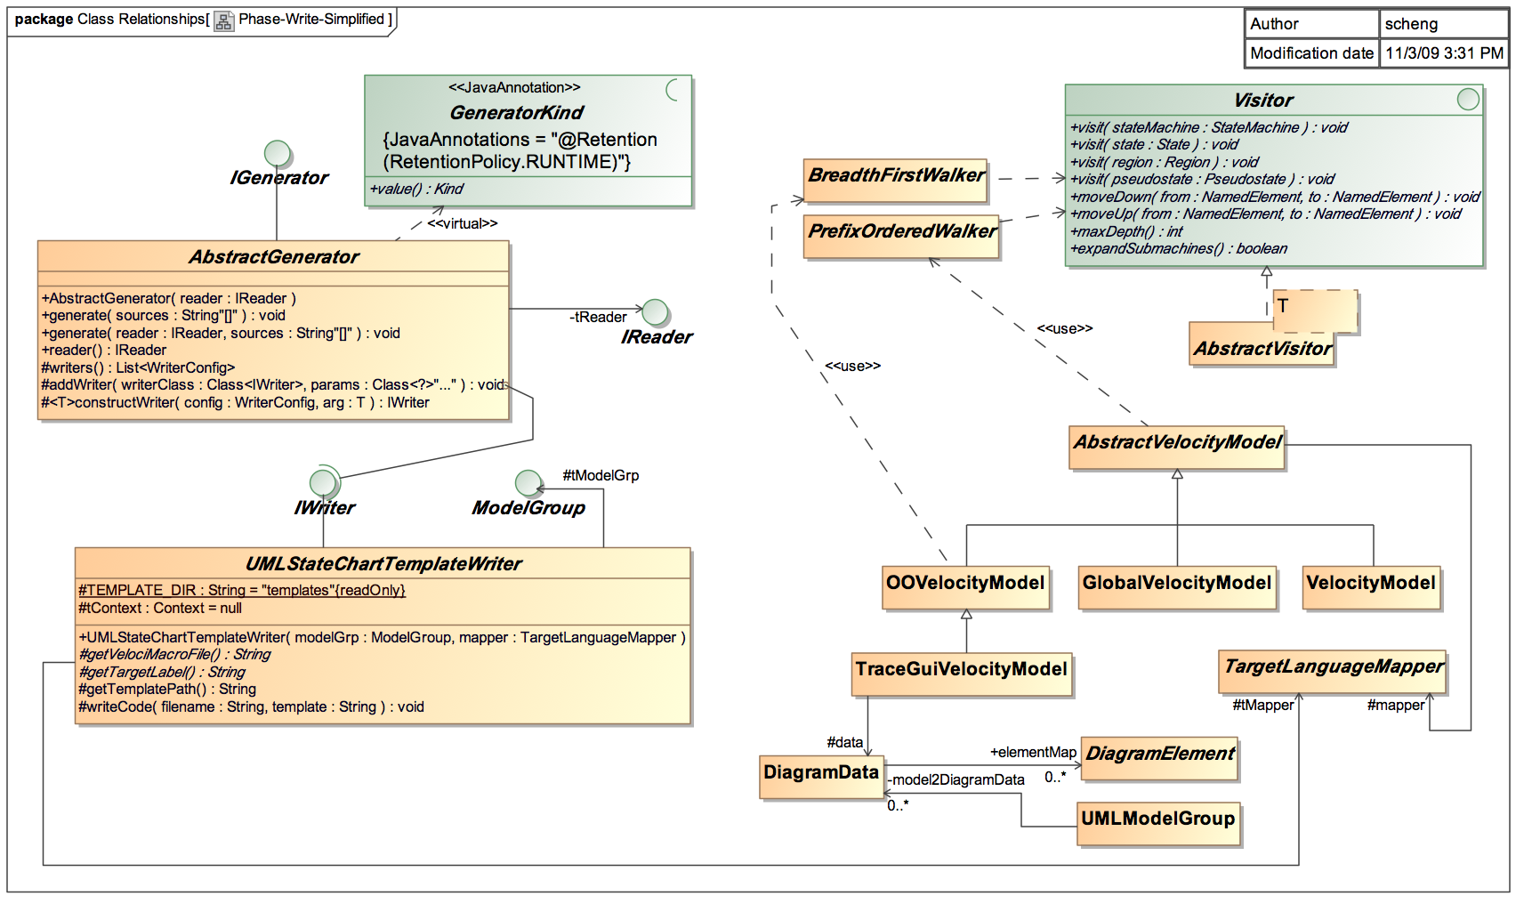
Write phase generates code using templates
R
V
W
Autocoder invokes
generators via
generate methods.
Java annotation
for (discoverable)
Generator classes.
Walkers + Visitors
for Model query
Model query
support classes
Base class takes care of setting up
and invoking the Velocity Engine;
other writers are possible
Notes:
Examples of Model query methods:
getStates()
getOrthogonalRegions()
getHistoryStates()

Slide 19
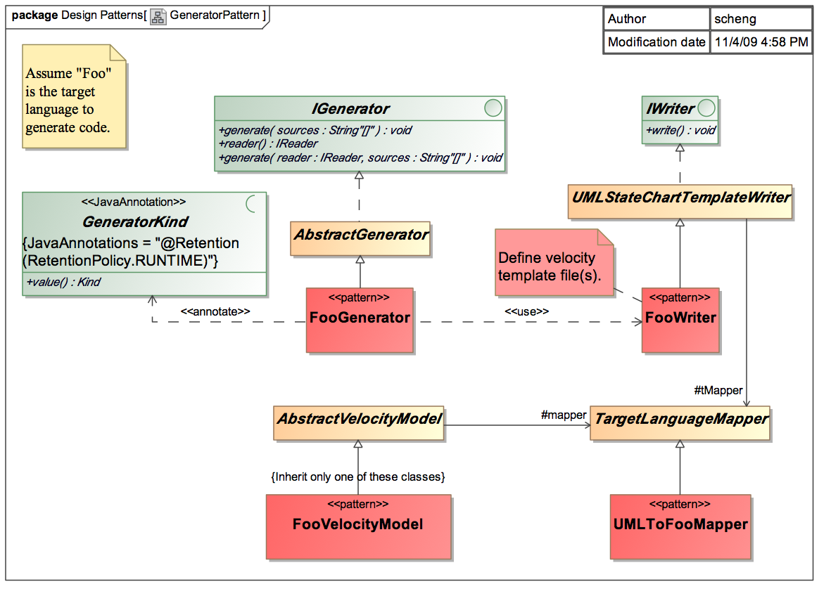
Generator and Writer design pattern
R
V
W
1.)
2a.)
2b.)
Define Velocity template modules
Macros aide modularity
Implement 3/+1 classes
Generator; annotate it
Writer; choose/add queries
Name Mapper for language
Iterate until desired output
2c.)
Notes:
Actually, what usually happens is you work on templates first
Then work backwards to fill in the classes, as needed.

Slide 20
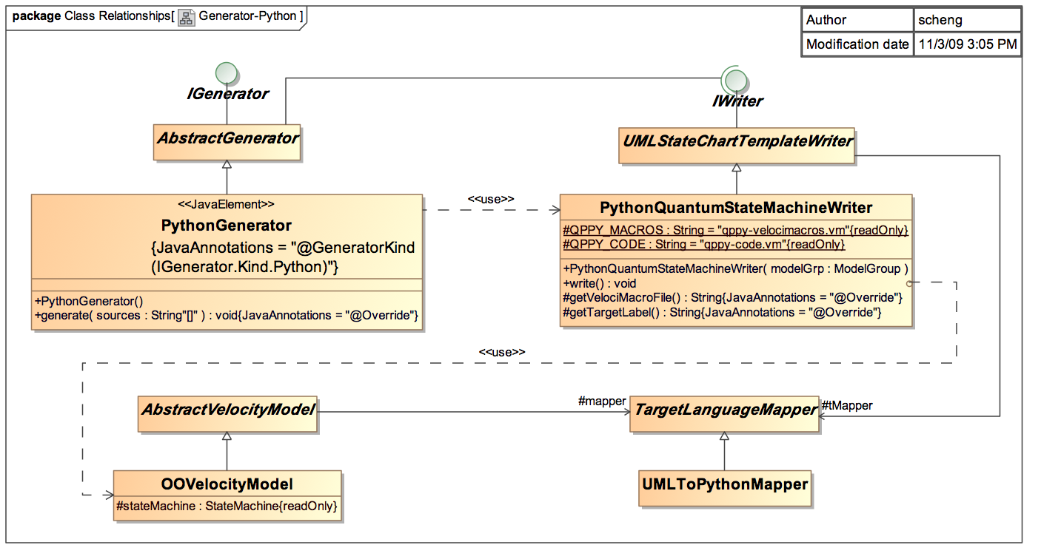
Pattern applied: Python Generator
R
V
W
generate() invokes write() writer(s)
write() merges Velocity template supplying Query and Mapper classes

Slide 21
Adding a new Target backend: YAML config.
R
V
W
Say we want to autocode a trace GUI configuration file
Model
SM_S
S1
S2
←
→
SM_X
X1
X2
←
→
Ev1
Ev2
Ev3
YmlGenerator
SM_S
YmlWriter
S1
getAllSMs()
getAllSignals()
getGeometry(StateMachine)
YmlQueryModel
S2
SM_X
X1
Yml-config.vm
#set($signals = $model.getAllSignals())
Signals:#for($s in $signals)
#*--*#${s}#if($velocityHasNext),#end
#end
#for($sm in $model.getAllSMs())
${model.makeUniqueName($sm)}:
type: ${sm.name}
geom: ${model.getGeometry($sm)}
#end`
X2
Signals: Ev1, Ev2, Ev3
sm_s1:
type: SM_S
geom: 200x200+20+20
sm_x1:
type: SM_X
geom: 200x200+240+240
Reader
Notes:
Explain what YAML is… yet-another mark-up language for human-readable XML.
Useful for storing data, in this case we’re using as configuration info.

Slide 22
Feature roadmap
Currently implemented back-ends on 2nd generation
C for Quantum Framework
Python for QF
Planned back-ends
C++ for QF
New Promela pattern
Richer trace GUI for state chart simulation
Support for a second (simpler) UML modeling tool
Application to generate other HSM design patterns
Boost, GoF’s State Design Pattern, etc.
Test plan generation
Notes:
Near-term enhancements
Support of OCL expression for guards
Enriching model validation to find more problems

Slide 23
Future issues
Apply grammar transformation technology?
UML grammar → target language using ANTLR
More exotic model transformation techniques?
UML Activity → StateChart → code using Eclipse Modeling Framework
Validation of UML meta-model
How to verify our implementation of UML Metamodel against standard
Template-based technology, good vs. bad?
Good: flexible and extensible
Issues: tension between code redundancy and logic complexity, no direct debugging support
Model-based test generation
Automatically generate test fixtures from state behaviors of applications
Apply model-checking technique using StateChart behavior model
In addition to generating Promela for SPIN checker, other checkers?

Slide 24
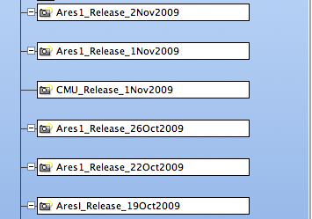
Current StateChart Autocoder Status
13KLOCs including 2364 SLOC of Velocity
SLOC Directory SLOC-by-Language (Sorted)
11395 src-notmpl java=11395
7204 src java=7204
3706 test ansic=1488,java=1321,python=897
Totals grouped by language (dominant language first):
Java: 19920 (89.31%)
ansic: 1488 (6.67%)
python: 897 (4.02%)
Generated using David A. Wheeler's 'SLOCCount’
Periodic software releases…
Missions supporting
Ares-I
SMAP

Slide 25
Conclusion
Briefly recounted history of the StateChart Autocoder
Problem: hard to get complex hierarchical state machines right
Solution: develop with standard-compliant StateCharts
Presented features of the new StateChart Autocoder
Extensible design patterns
UML metamodel support
Use of template technology
Demonstrated SC Autocoder in action
Showed ease of adding a generator back-end with YAML
Mentioned planned back-ends, better GUI, more testing
Discussed future issues on modeling, validation, etc.
Notes:
UML StateChart Autocoder makes it easier to get complex hierarchical state machines right
2nd gen: UML metamodel, design patterns, and templates
Demo’d SC Autocoder and ease of adding back-end
Roadmap: planned back-ends, better GUI, more testing

Slide 26
The End
Questions?
Shang-Wen Cheng <owen.cheng@jpl.nasa.gov> Software Engineer 316D Flight Software Apps & Data Product Mgmt
Thank you!

Slide 27
Supplementals

Slide 28
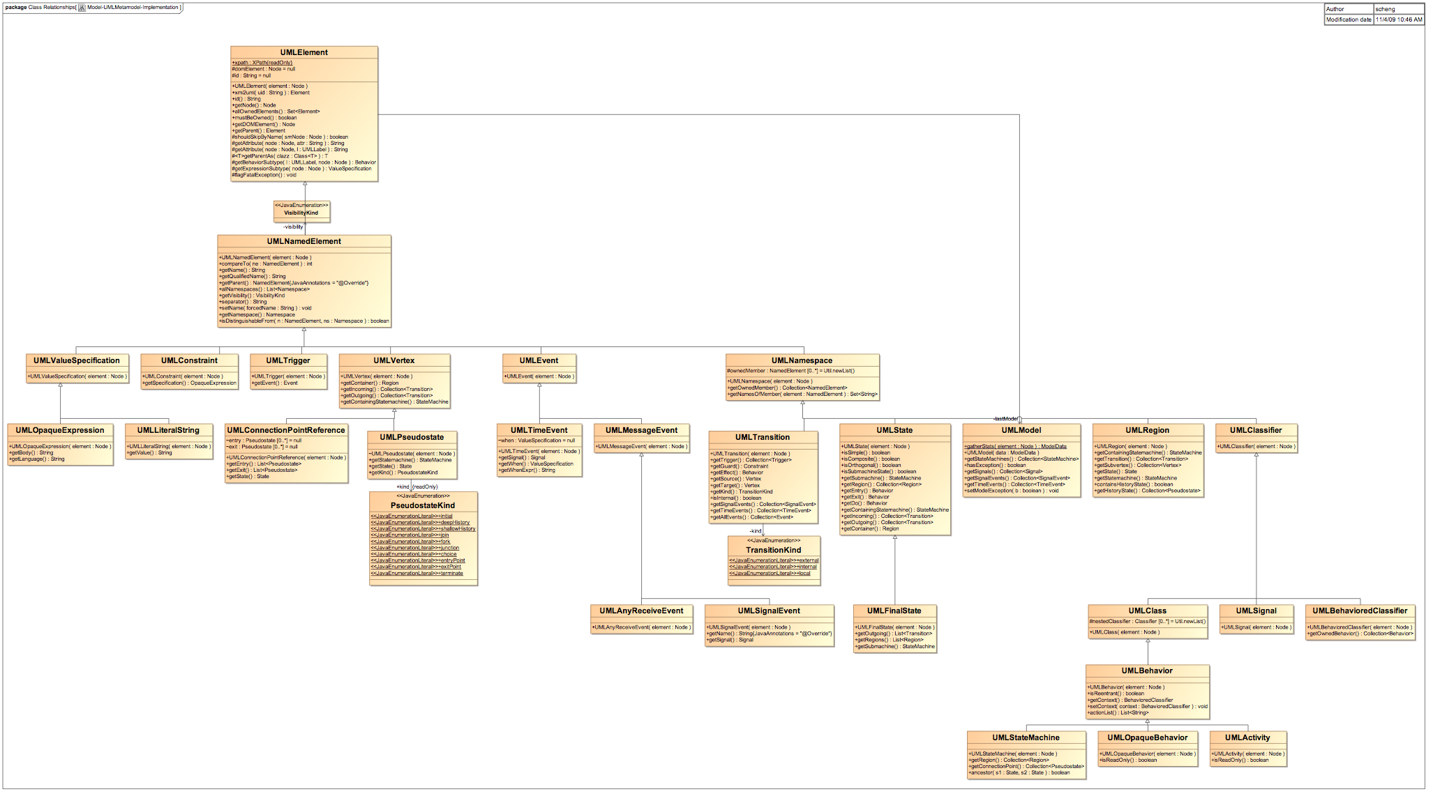
UML Metamodel implementation classes

Slide 29
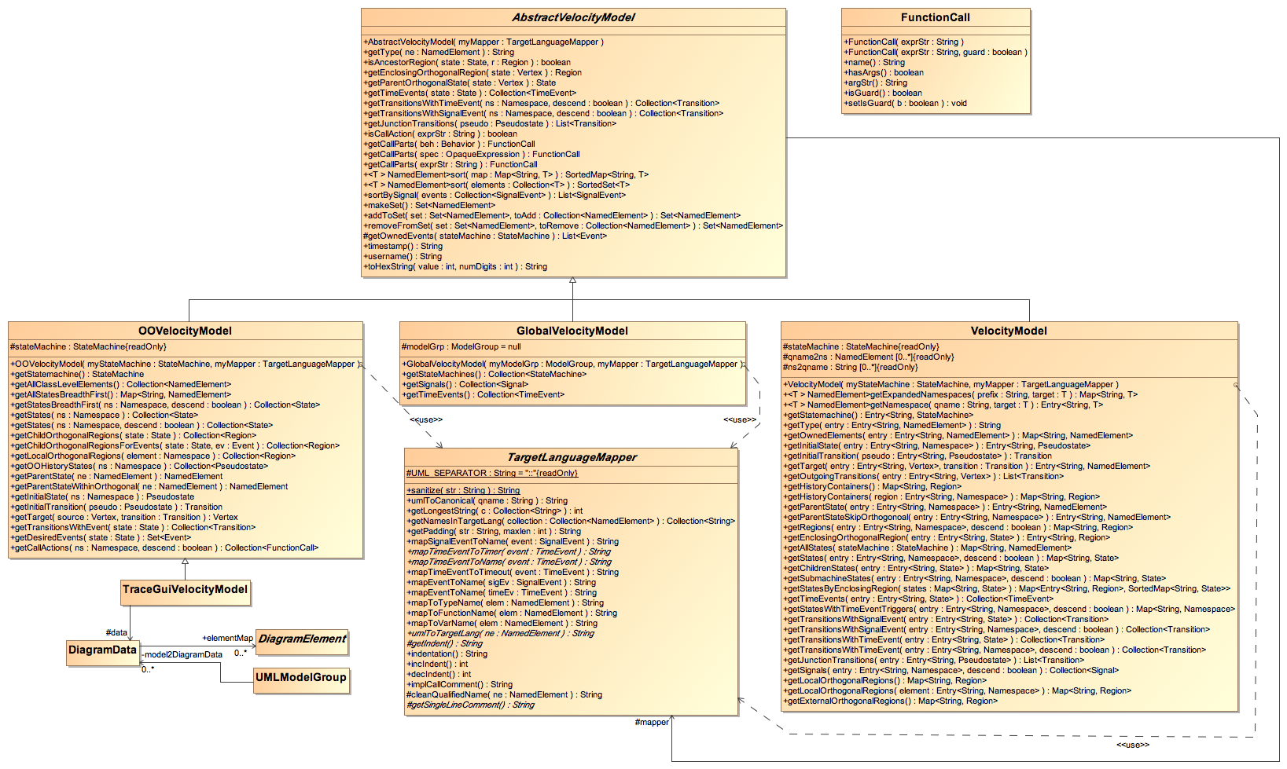
UML model query classes for Velocity

